Slide 1
THIERRY HENRY

Slide 2
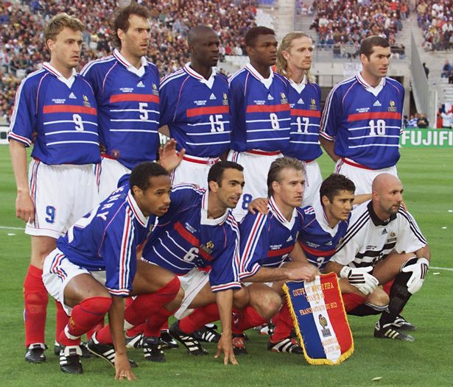
HIS EARLY LIFE
HE played for AS Moscow under wenger
He won the world cup with France in 1998
After winning the world cup Juventus bought him

Slide 3
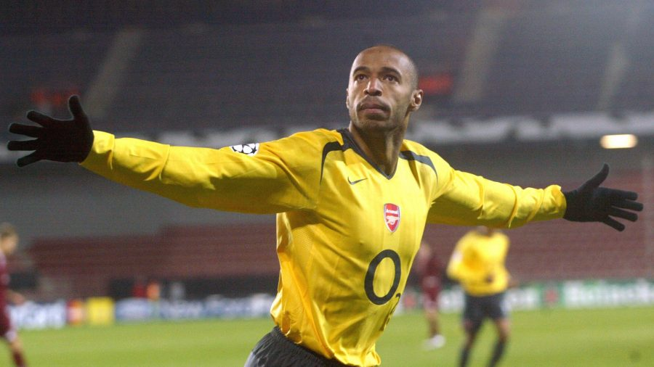
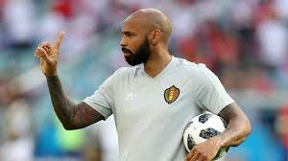
Henry at arsenal
He became 4 times league scoring champion and twice player of the year

Slide 4
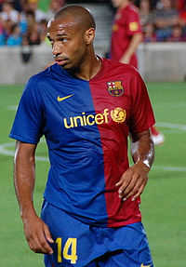
Henry at barcelona
With 26 goals and 10 assists as a left winger he won his first trophy at barcelona

Slide 5
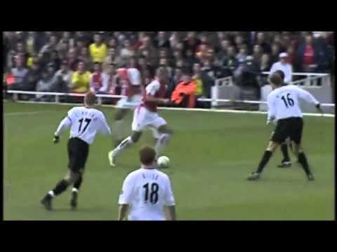
video

Slide 6

ANY QUESTIONS ?

